Slide 1
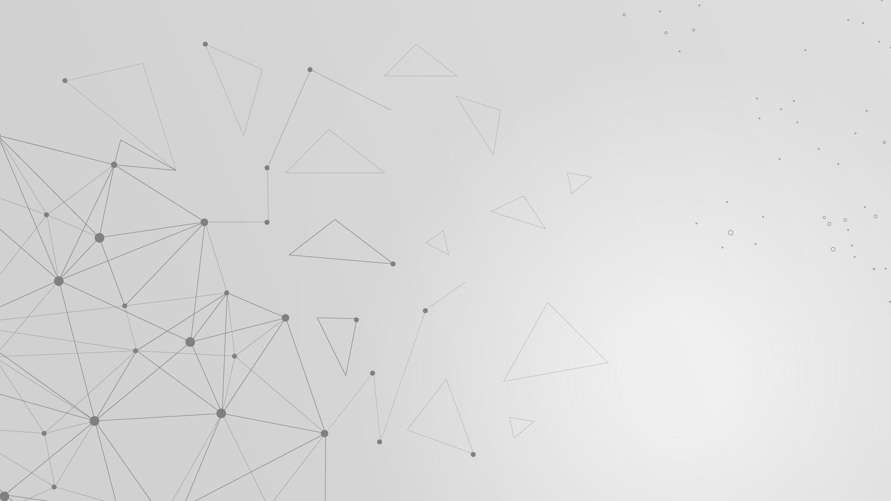
Graph Neural Networks (GNN)

Slide 2
Current Goal of Project
To reduce the error achieved by the SEGNN model, possibly achieved by any other model
To do so i am using Attention mechanism over existing models.
I have achieved some favourable results to support my research direction.

Slide 3
Before we Begin…
Attention Mechanism: In the context of GATs, attention is used to learn the importance or relevance of neighboring nodes' features for a specific node. Attention coefficients act as weights that indicate how much attention or focus should be given to each neighboring node. In GATs, attention allows the network to learn which neighboring nodes are most relevant for updating a specific node's embedding.

Slide 4
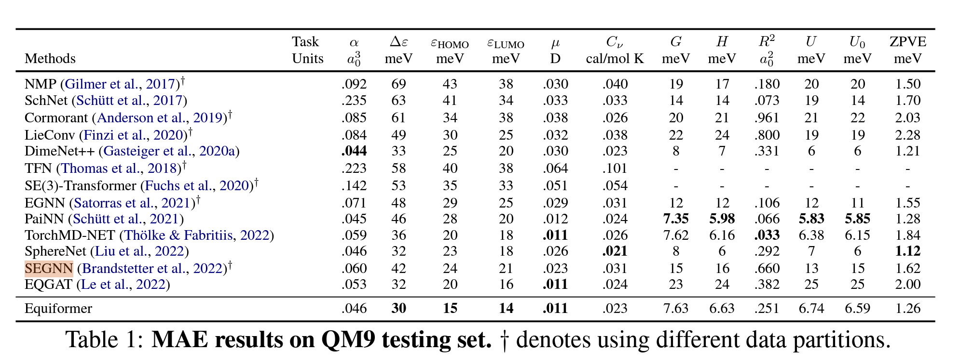
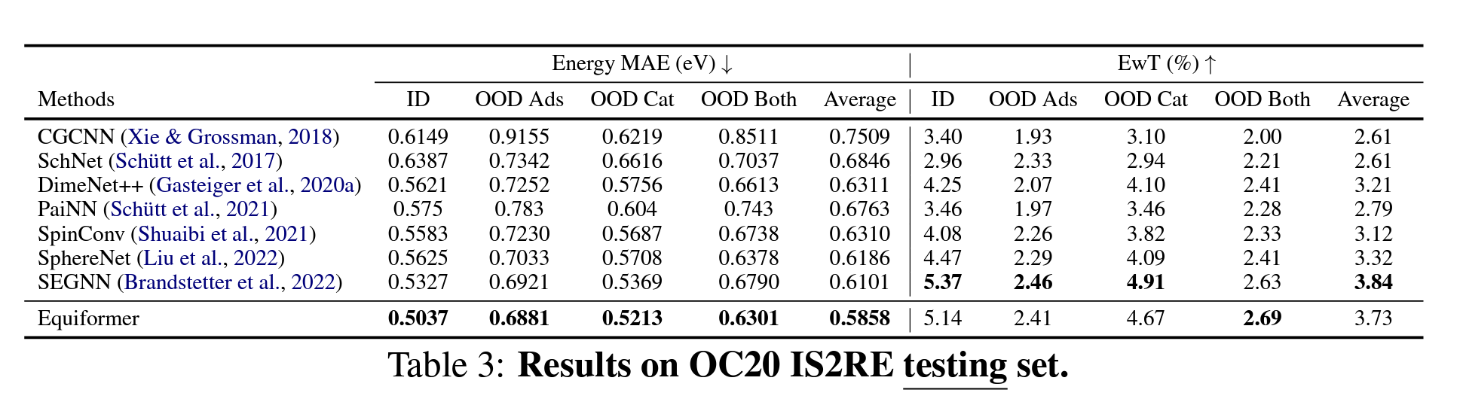
Comparison of Results from various papers

Slide 5
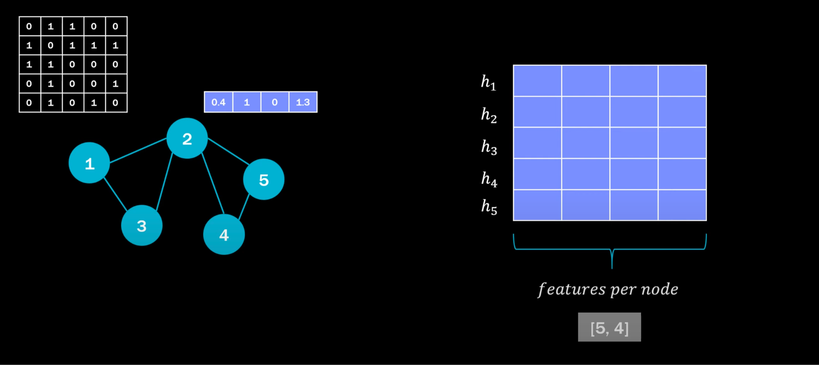
How GNN Works…

Slide 6
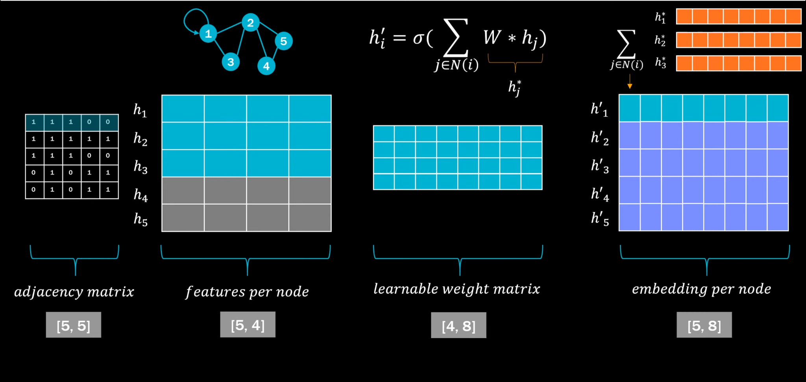
The Overall Picture of Classical GNN

Slide 7
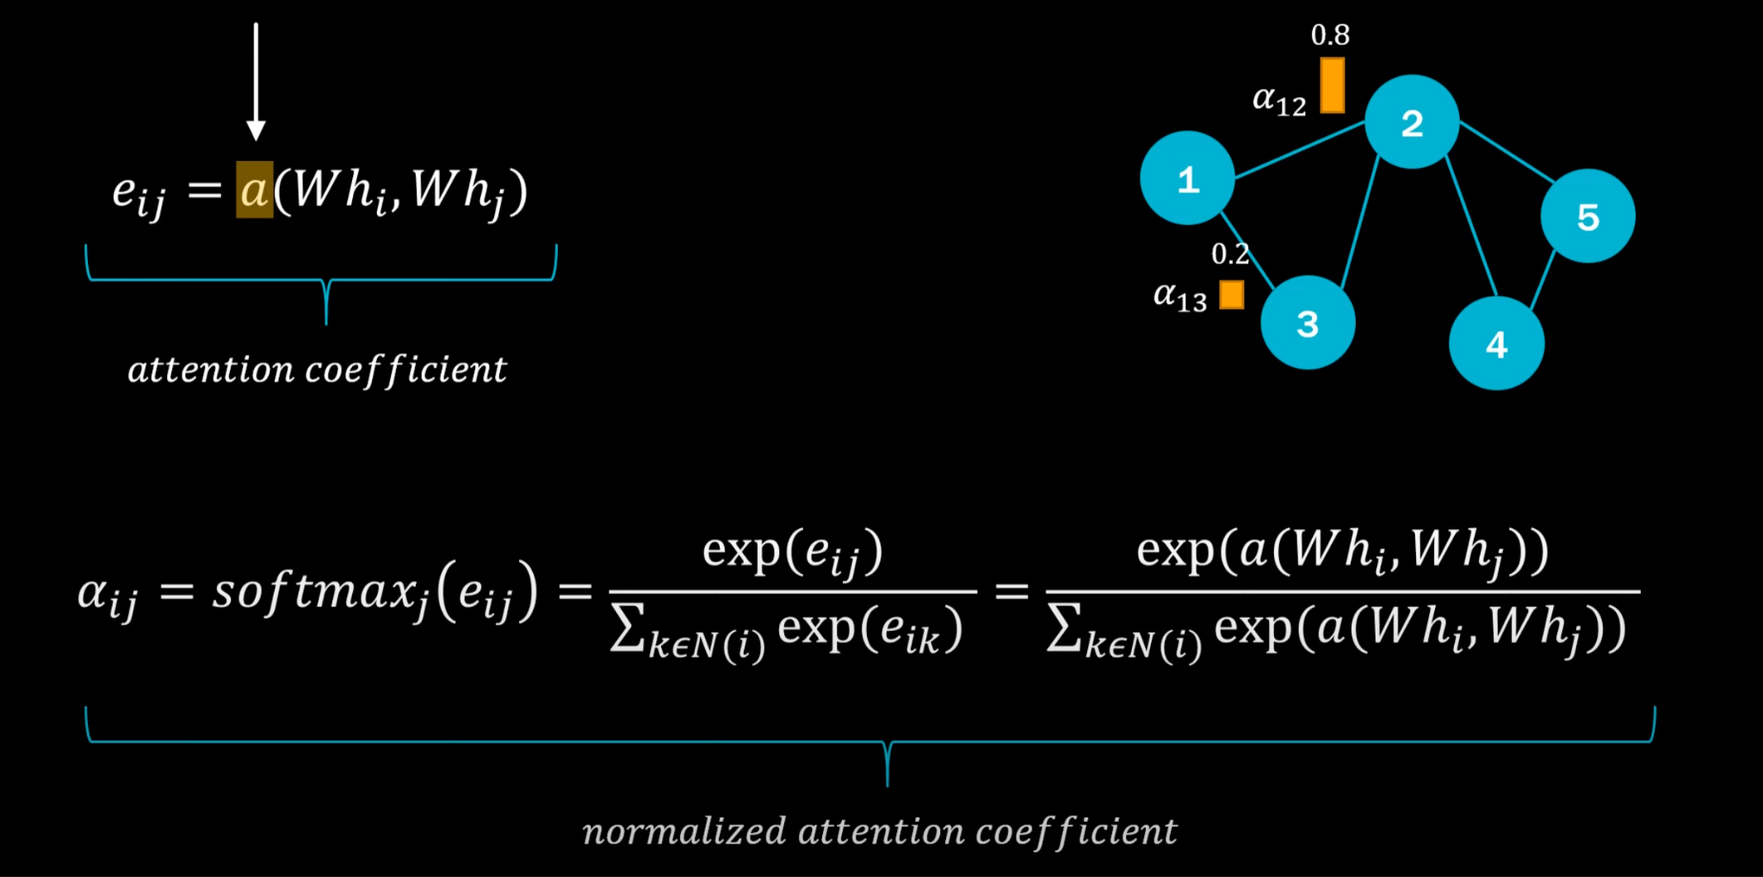
How Attention Comes in Play…

Slide 8
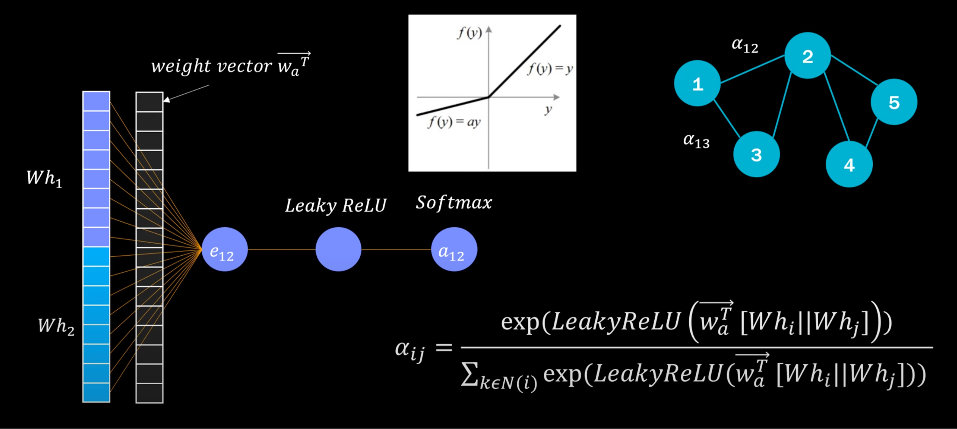
Adding Attention…

Slide 9
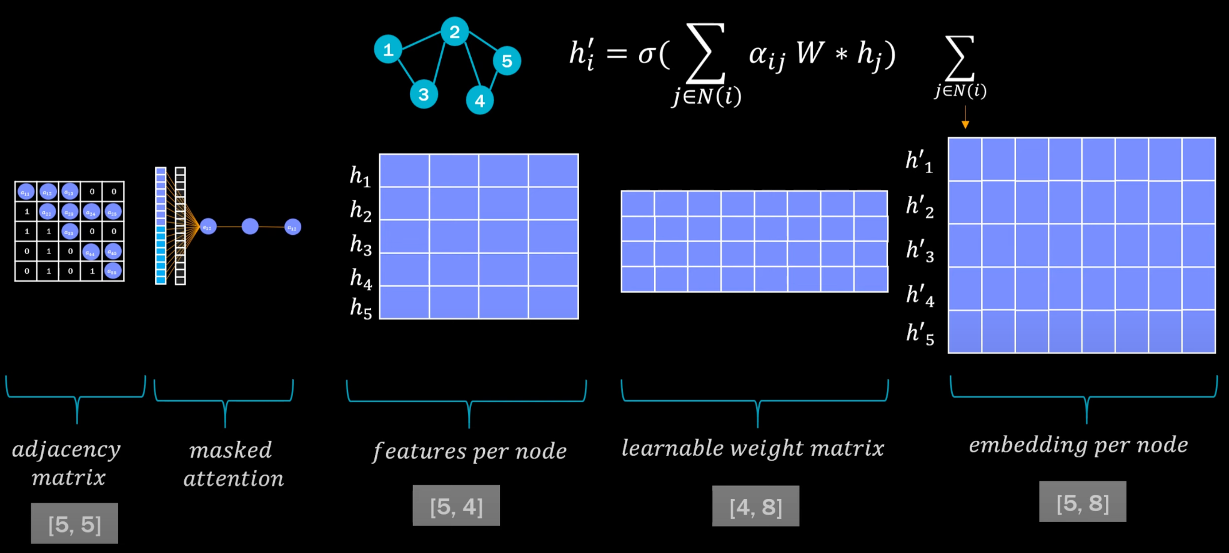
Putting it all together…

Slide 10
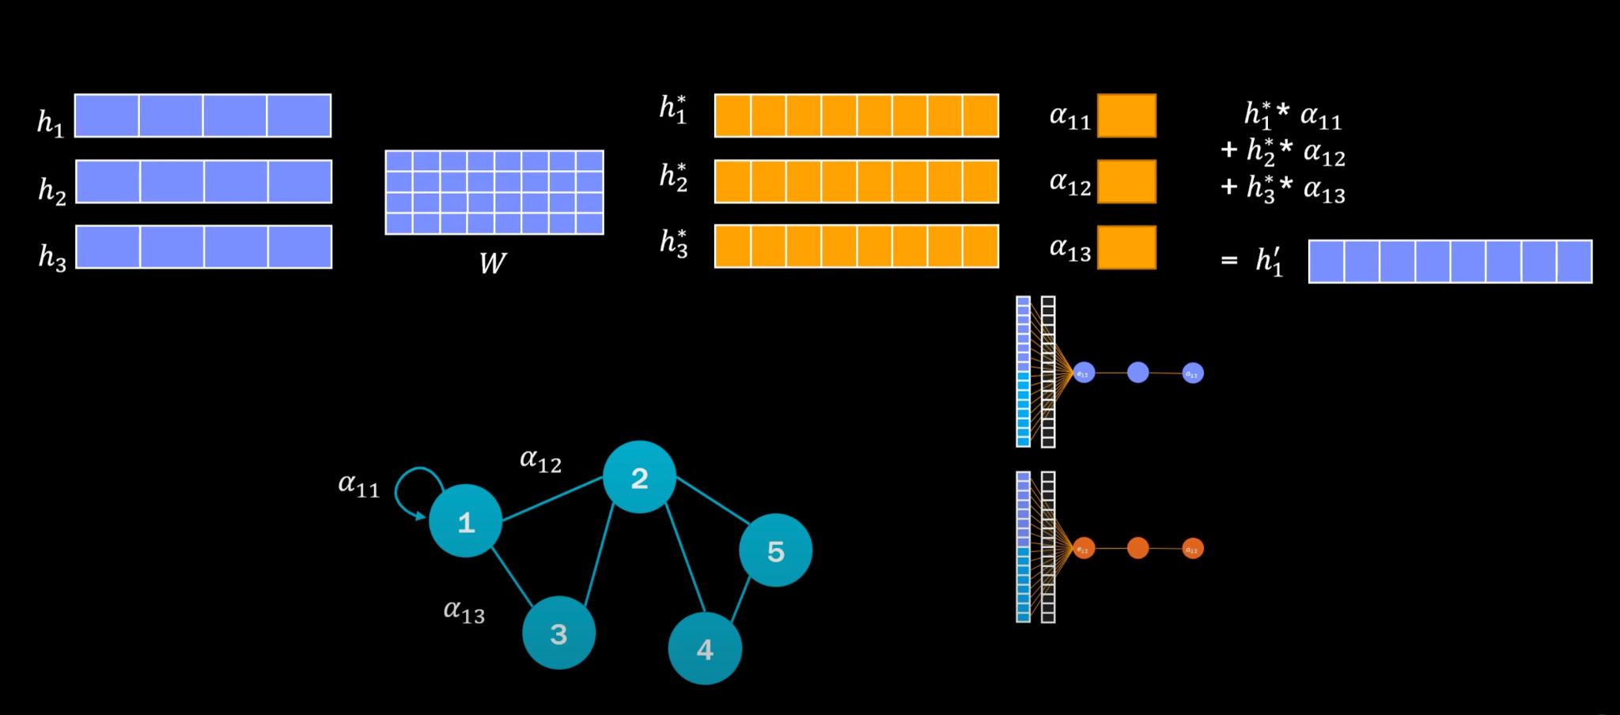
Multi-head Attention…

Slide 11
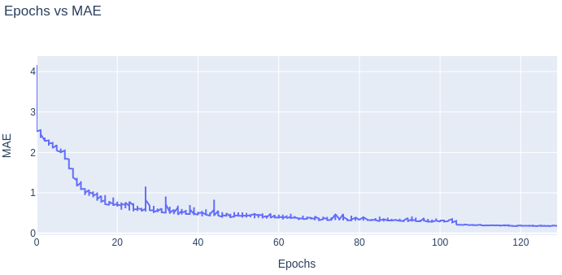
Results for 1 layer of SEGNN with attention

Slide 12
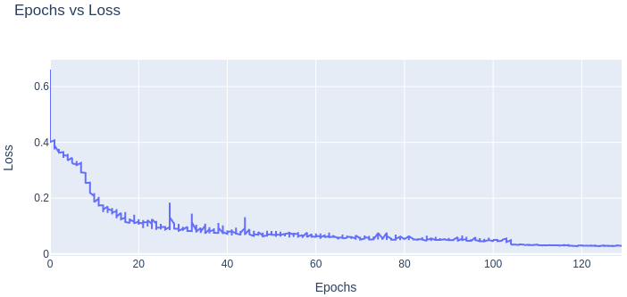
Results for 1 layer of SEGNN with attention

Slide 13
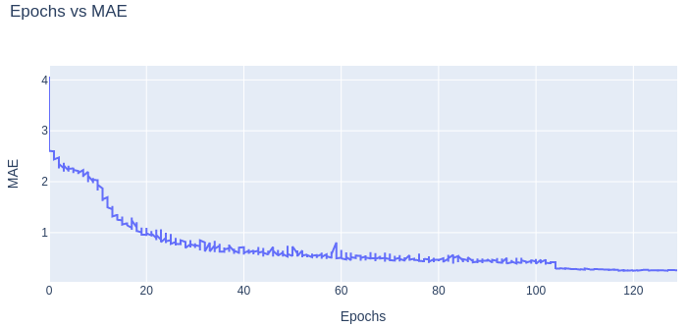
Original SEGNN Code

Slide 14

Original SEGNN Code

Slide 15
Further Explorations to improve results…
Increase the number of (Attention-SEGNN) layers.
Using multi-headed attention for each (Attention-SEGNN) layer.
Using a combination of (Attention-SEGNN) and (SEGNN) layers.
Using pre-defined GAT(Graph Attention Network layers) with SEGNN or (Attention-SEGNN) layers in combinations.
Increasing the number of layers in Attention mechanism in current implemented model (from 1 NN layer to some say, ‘n’ NN layers).
Using some combination of all the above methods.
As Ramzan’s sir said… Applying Attention over Tensors quantities is somewhat different than Applying Attention over Scalar Quantities. Perhaps, we should change how we are applying attention in the SEGNN Model.

Slide 16
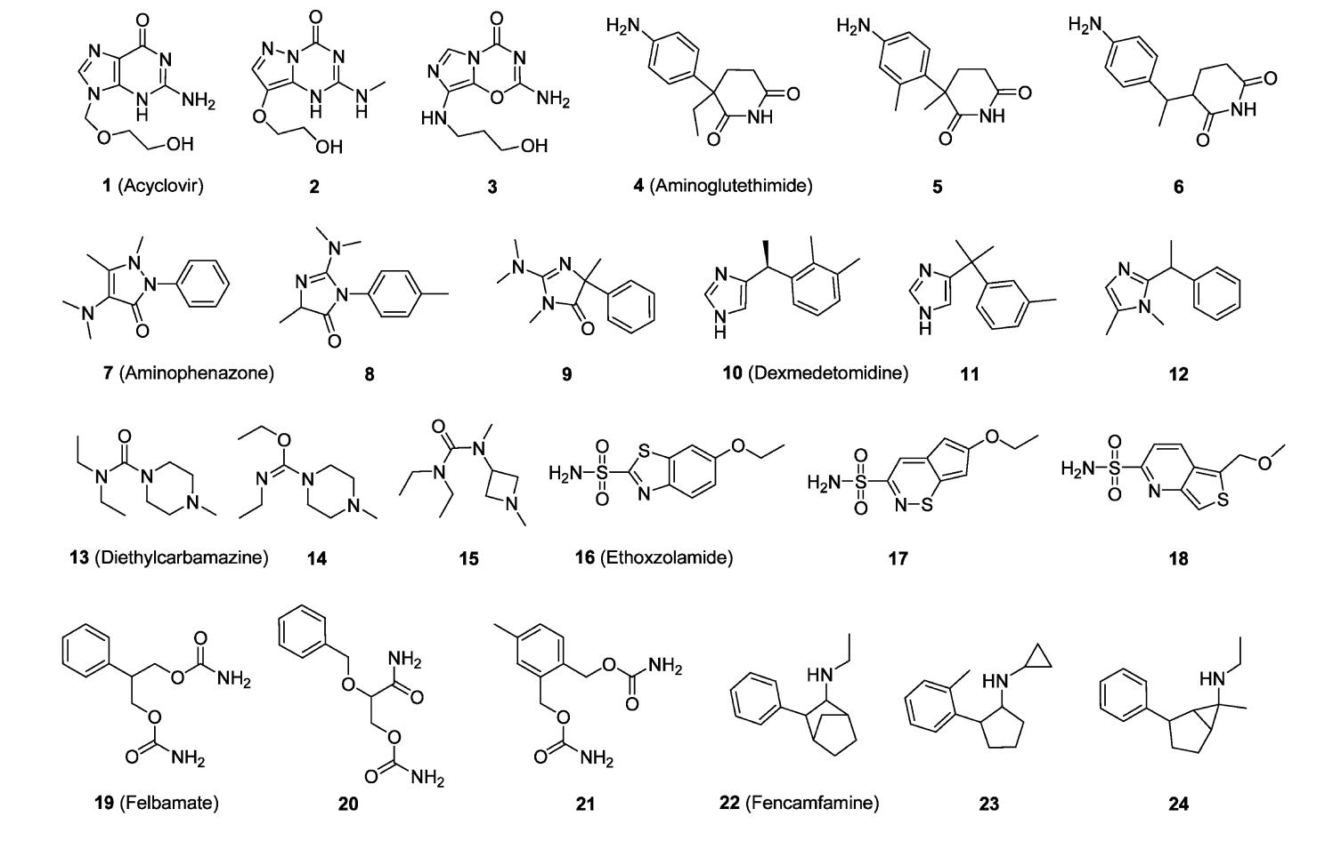
QM9 Dataset

Slide 17
Thank you for your time!

